Slide 1
WEB ANALYTICS
HUMAN DISEASE-SYMPTOM NETWORK
Saumya Agarwal
Sun Qianqian
Wang Yanhang
Ye Jialiang

Slide 2

CONTENTS
01
Data Pre-processing
02
Community Detection
03
Keyplayer Detection
04
Visualization & Insights

Slide 3

01
Data Pre-processing

Slide 4
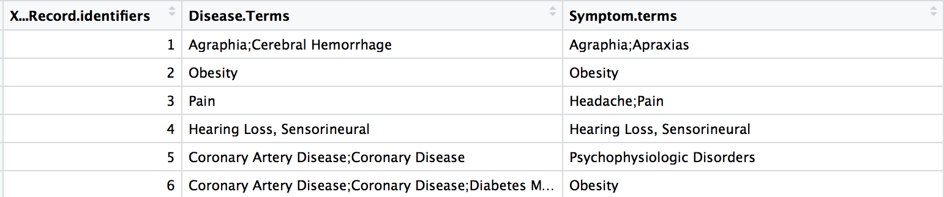
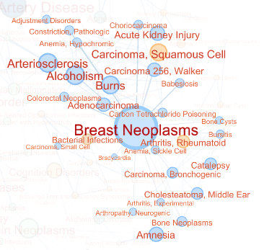
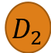
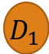

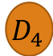
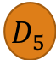
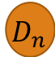
Introduction
Disease and Symptom
Diseases
$$D_{1}$$
$$D_{2}$$
$$D_{3}$$
$$D_{4}$$
$$D_{5}$$
…
$$D_{n}$$
Symptoms
S₁
S₂
S₃
S₄
…
S_{m}

Slide 5
Data Pre-processing
Record ID | Diseases | Symptoms
1 | Agraphia; Cerebral Hemorrhage | Agraphia; Apraxias
2 | Coronary Artery Disease; Coronary Disease; Diabetes Mellitus, Type 2 | Obesity
3 | Neuralgia | Facial Pain; Low Back Pain; Neuralgia
dis<-cSplit(disease,"Disease.Terms",";",direction = "long")
dis<-cSplit(dis,"Symptom.terms",";",direction = "long")

Slide 6
Split Disease and Symptom
Record ID | Diseases | Symptoms
1 | D1,D2 | S1
2 | D3 | S1,S3
Record ID | Diseases | Symptoms
1 | D1 | S1
1 | D2 | S1
2 | D3 | S1
2 | D3 | S3

Slide 7
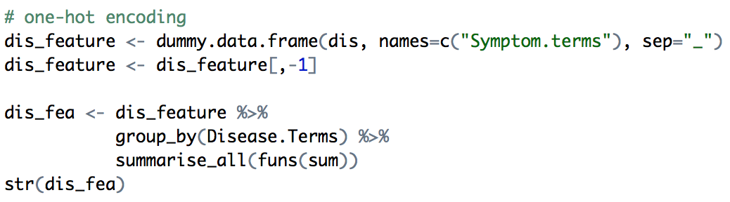
One-hot Encoding
Record ID | Diseases | Symptoms
1 | D1 | S1
1 | D2 | S1
2 | D3 | S1
2 | D3 | S3
Disease | Symptoms_S1 | Symptoms_S2 | Symptoms_S3
D1 | 1 | 0 | 0
D2 | 1 | 0 | 0
D3 | 1 | 0 | 1

Slide 8
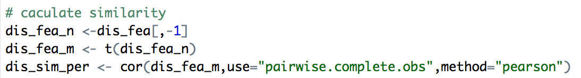
Calculate the Similarity
Disease | Symptoms_S1 | Symptoms_S2 | Symptoms_S3
D1 | 1 | 0 | 0
D2 | 1 | 0 | 0
D3 | 1 | 0 | 1
 | D1 | D2 | D3
D1 | 1 | -0.006915490 | -0.007144623
D2 | -0.006915490 | 1 | 0.372935908
D3 | -0.007144623 | 0.372935908 | 1

Slide 9
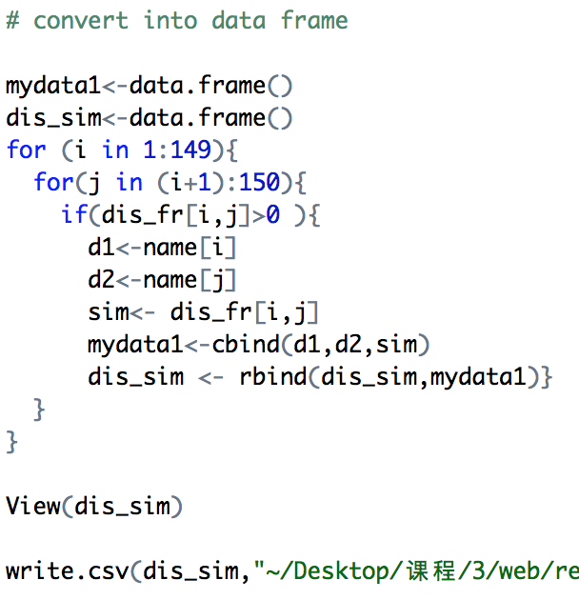
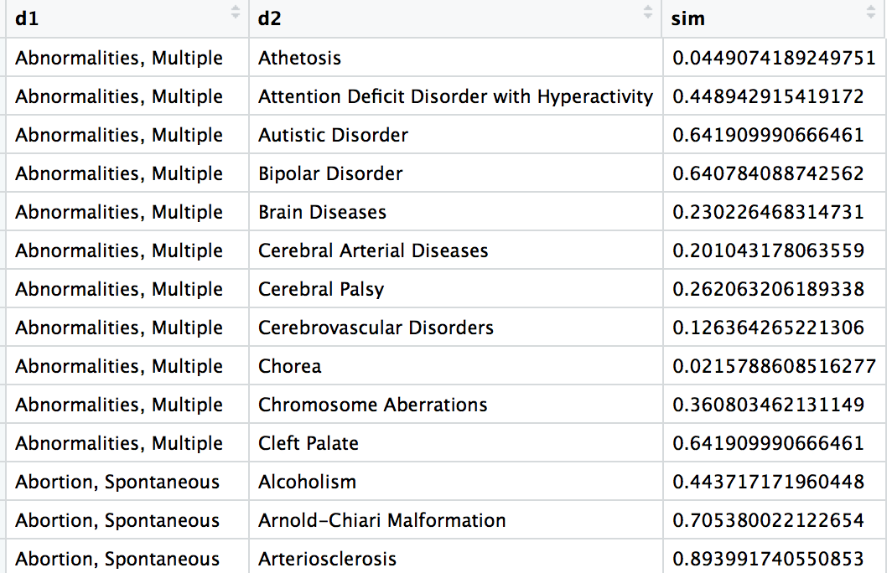
Re written as a standard form

Slide 10
02
Community Detection

Slide 11
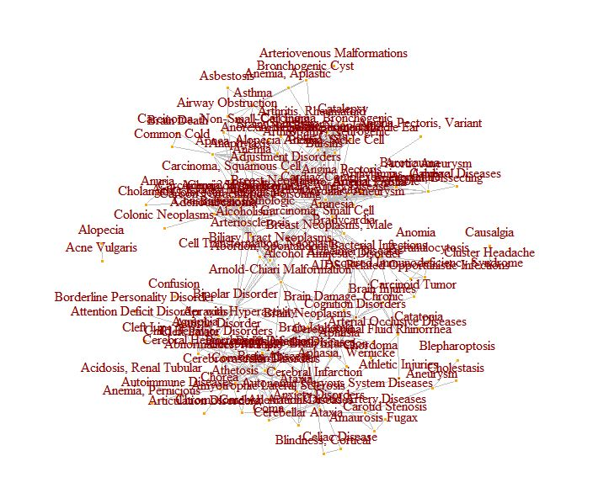
Community Detection
Vertex Count: 127 + 4 unconnected
Transitivity: 0.4602273
Density: 5.961755
Diameter: 2.188508
Clique Number: 9
Vertex with Maximum Betweenness value: Coronary Artery Disease
Vertex with Maximum Closeness centrality: Coronary Artery Disease

Slide 12
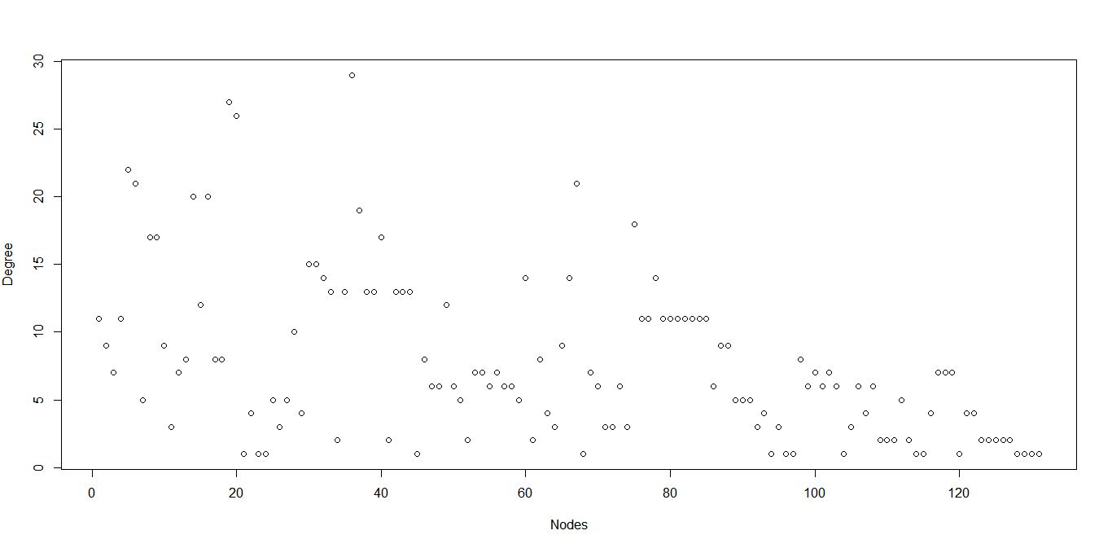
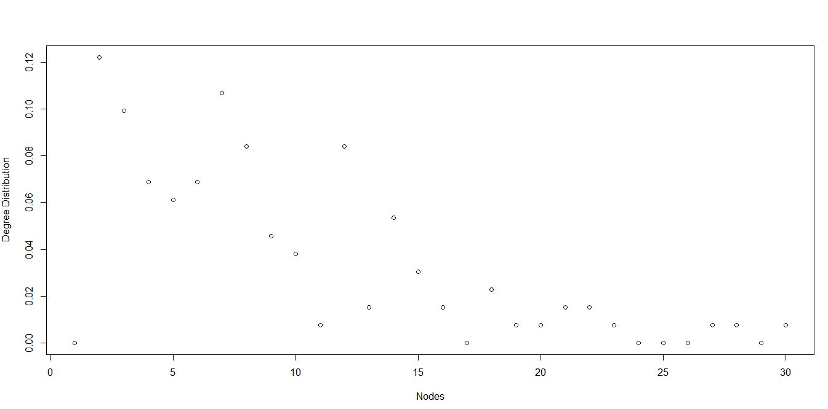
Basic Concepts of Graph
Degree Distribution: Given a network graph G, we define f_{d} to be the fraction of vertices v ∈ V with degree dv = d. The collection { fd}d≥0 is called the degree distribution of G, and is simply a rescaling of the set of degree frequencies
Degree: The degree dv of a vertex v, in a network graph G = (V,E), counts the number of edges in E incident upon v.

Slide 13
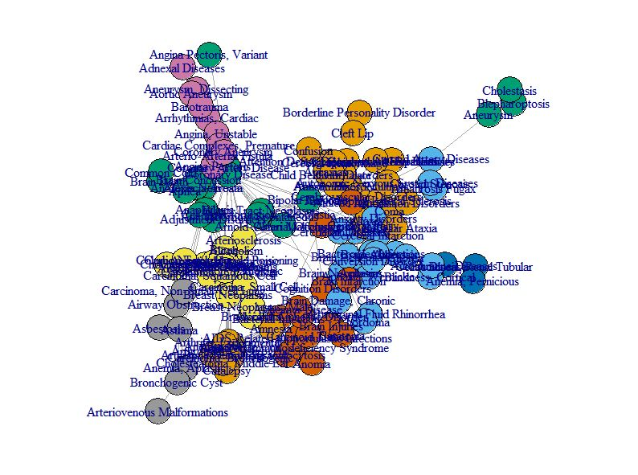
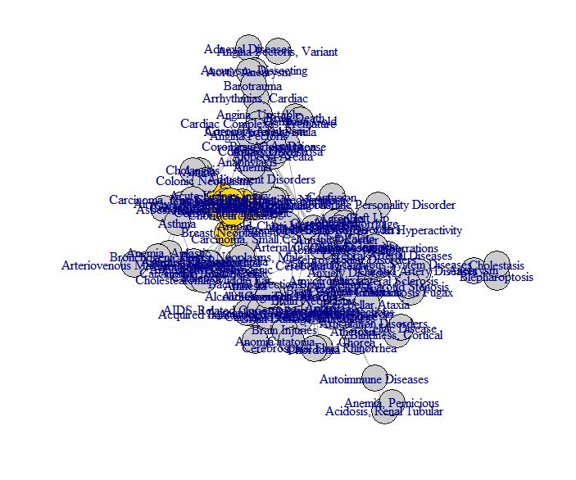
Clique-Based Community Detection
A clique, C, in an undirected graph G = (V, E) is a subset of the vertices, C ⊆ V, such that every two distinct vertices are adjacent. This is equivalent to the condition that the induced subgraph of G induced by C is a complete graph.
cliques(g, min=9, max=9)
largest.cliques(g)

Slide 14
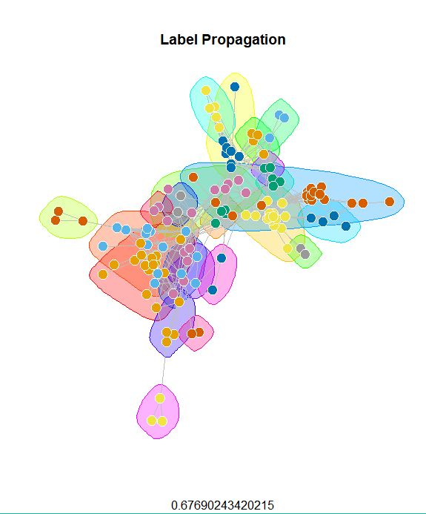
Label propagation community Detection
The label propagation algorithm uses an iterative process to find stable communities in a graph. The method begins by giving each node in the graph a unique label. Then, the algorithm iteratively simulates a process in which each node in the graph adopts the label most common amongst its neighbours. The process repeats until the label of every node in the graph is the same as the label of maximum occurrence amongst its neighbours.
Modularity – 0.6769024
lab <- label.propagation.community(g)
modularity(lab)

Slide 15
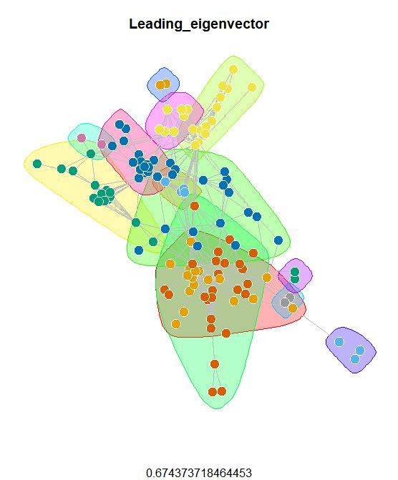
Leading eigenvector community Detection
The leading eigenvector method works by calculating the eigenvector of the modularity matrix for the largest positive eigenvalue and then separating vertices into two community based on the sign of the corresponding element in the eigenvector. If all elements in the eigenvector are of the same sign that means that the network has no underlying community structure.
Modularity – 0.6743737
lec <- leading.eigenvector.community(g,options=list(maxiter=1000000))
modularity(lec)

Slide 16
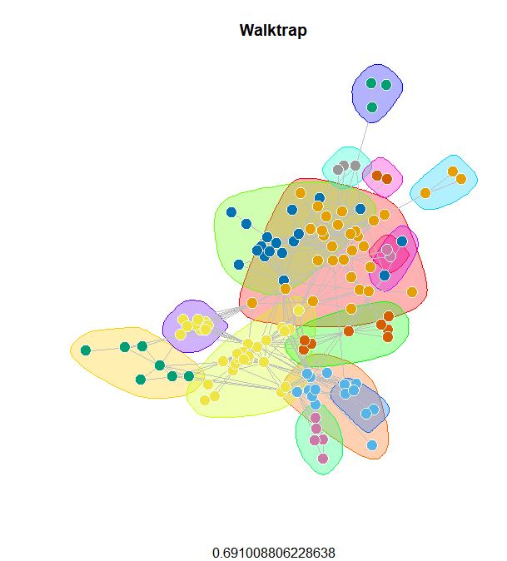
Walktrap Community Detection
This algorithm finds densely connected subgraphs by performing random walks. The idea is that random walks will tend to stay inside communities instead of jumping to other communities.
Modularity – 0.6910088
wc <- walktrap.community(g)
modularity(wc)

Slide 17
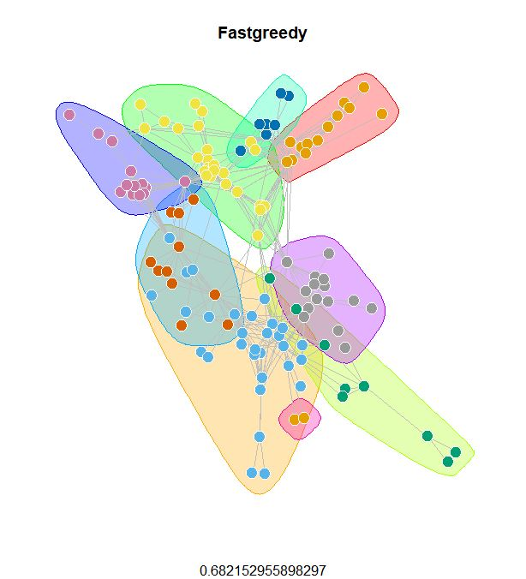
Fastgreedy community Detection
In this case the algorithm is agglomerative. At each step two groups merge. The merging is decided by optimising modularity. This is a fast algorithm, but has the disadvantage of being a greedy algorithm. Thus, is might not produce the best overall community partitioning.
Modularity – 0.682153
g1 <- simplify(g)
fc <- fastgreedy.community(g1)

Slide 18
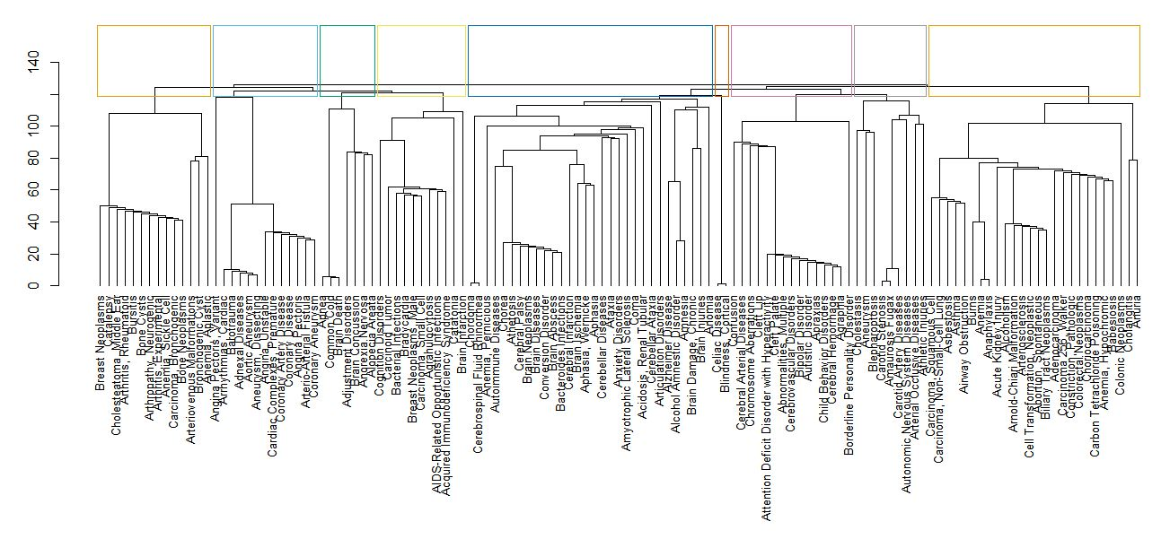
Fastgreedy community Detection
Modularity – 0.682153

Slide 19
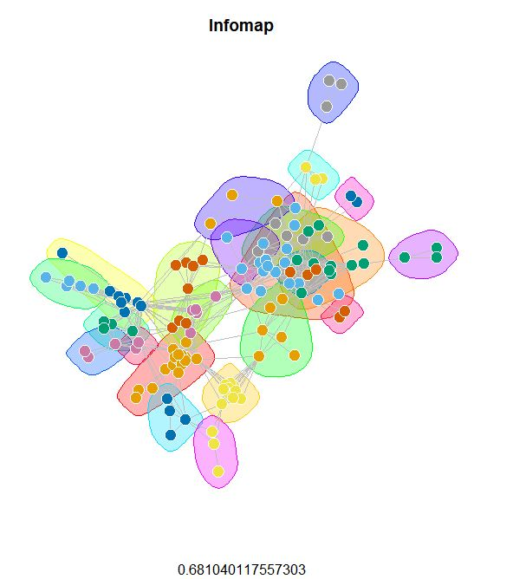
Infomap Community Detection
The Infomap algorithm is based on the principles of information theory. Infomap characterizes the problem of finding the optimal clustering of a graph as the problem of finding a description of minimum information of a random walk on the graph. The algorithm maximizes an objective function called the Minimum Description Length, and in practice an acceptable approximation to the optimal solution can be found quickly.
Modularity – 0.6810401
ic <- infomap.community(g1)
modularity(ic)

Slide 20
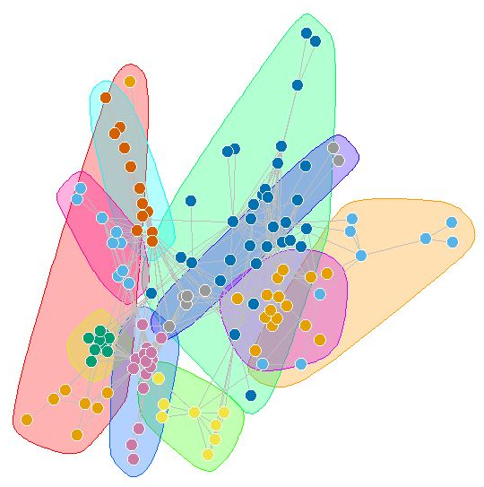
Spinglass community Detection
This algorithm uses as spin-glass model and simulated annealing to find the communities inside a network. The community structure of the network is interpreted as the spin configuration that minimizes the energy of the spin glass with the spin states being the community indices. We elucidate the properties of the ground state configuration to give a concise definition of communities as cohesive subgroups in networks that is adaptive to the specific class of network under study.
Modularity – 0.8768559
set.seed(1234)
sc <- spinglass.community(g, spins=10)

Slide 21
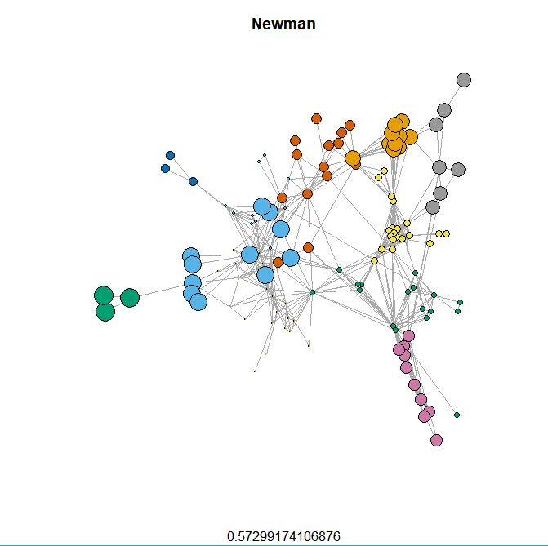
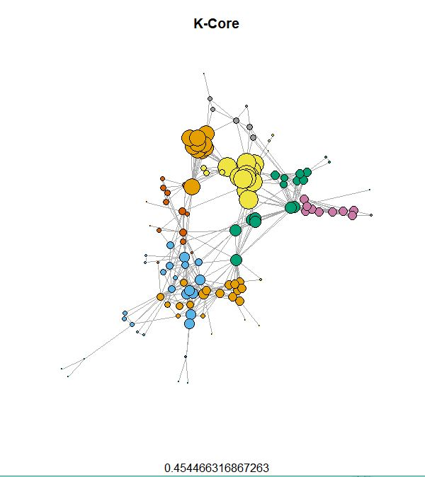
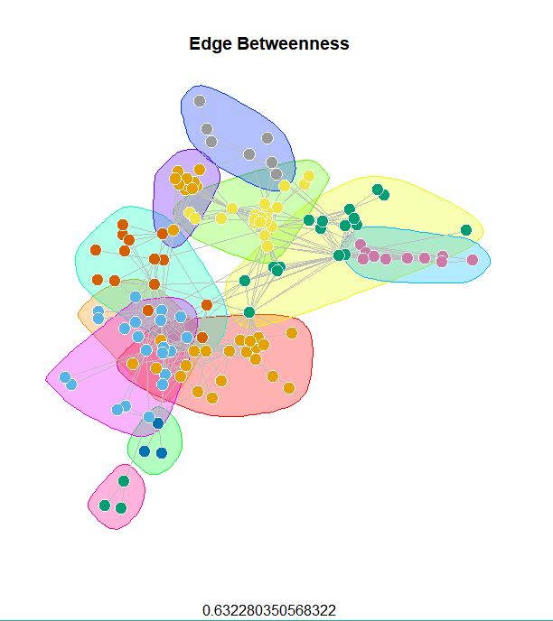
Comparison of Different Algorithms
Girvan-Newman
K-Core Decomposition
Edge Betweenness
Modularity – 0.5729917
Modularity – 0.4544663
Modularity – 0.6322804
mods <- sapply(0:ecount(g), function(i){
g2 <- delete.edges(g, ebc$removed.edges[seq(length=i)])
cl <- clusters(g2)$membership
kc <- coreness(g, mode="all")
modularity(g,kc)
eb <- edge.betweenness.community(g)
modularity(eb)

Slide 22
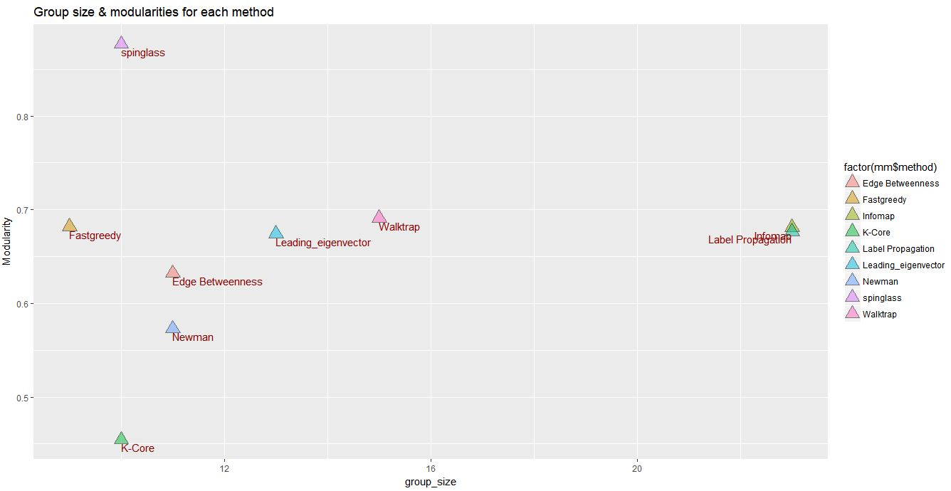
Comparison of Different Algorithms
High modularity for a partitioning reflects dense connections within communities and sparse connections across communities.

Slide 23
03
Keyplayer Detection

Slide 24
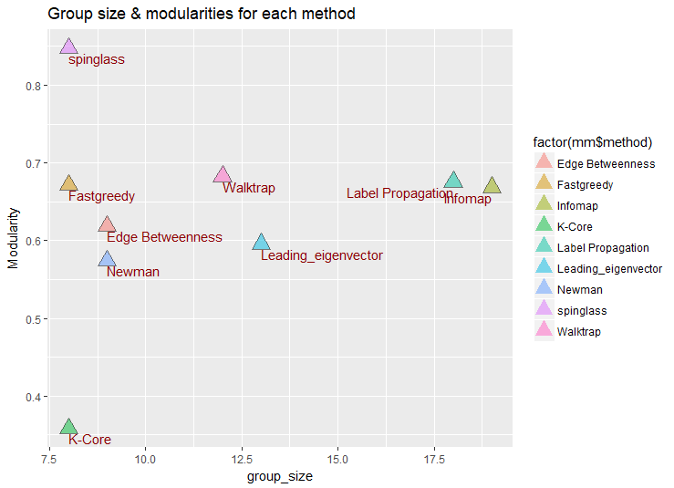
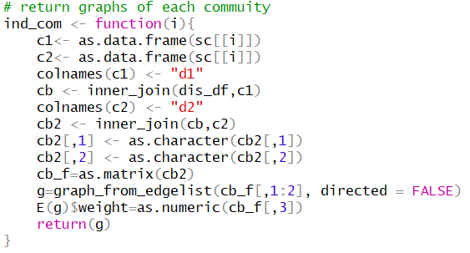
Keyplayer Detection
Use the community results obtained by springlass methods
higher modularity: 0.878~0.907
smaller group size : 9 communities

Slide 25
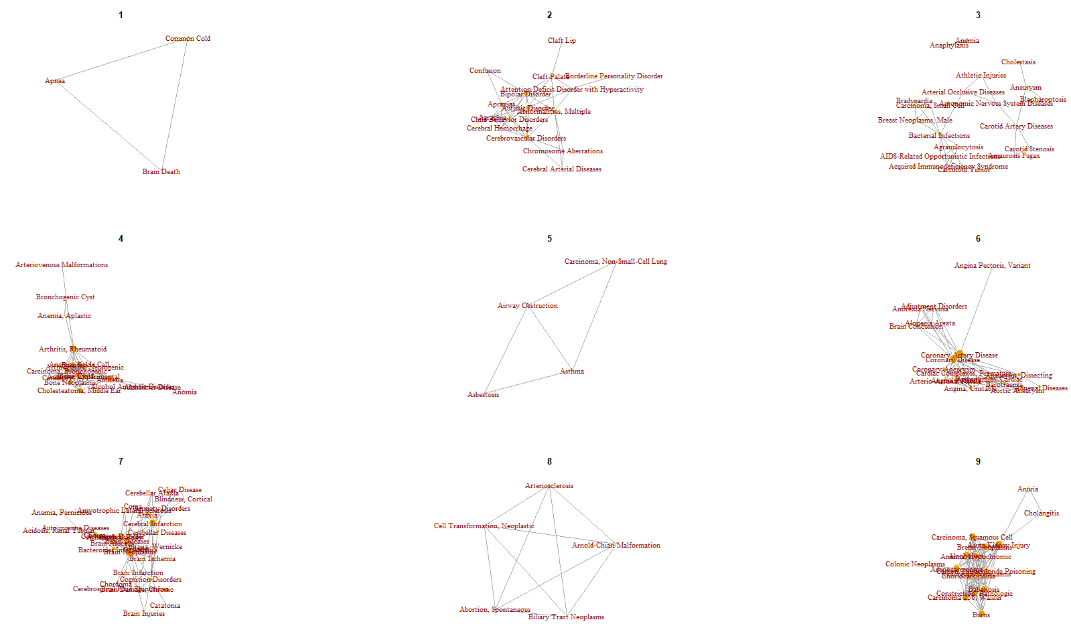
9 Communities Formed by Spinglass

Slide 26
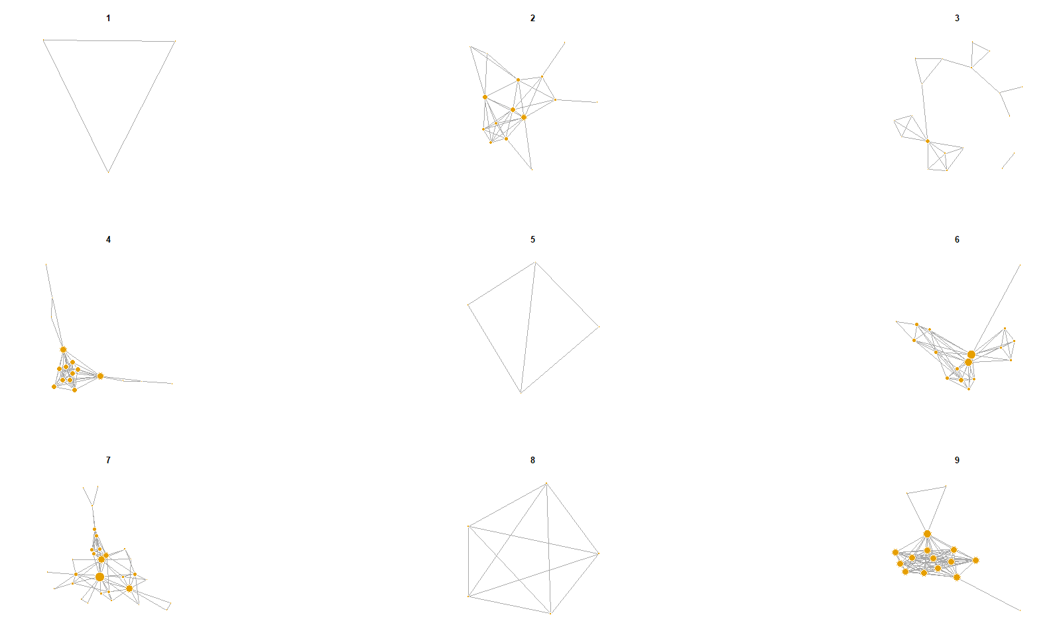
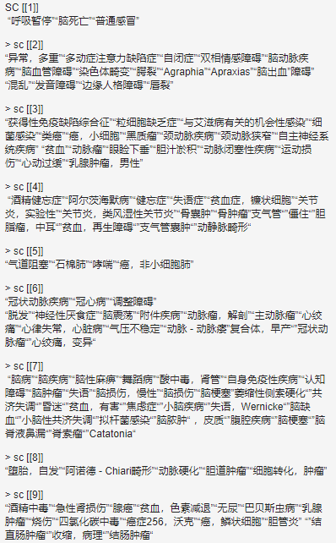
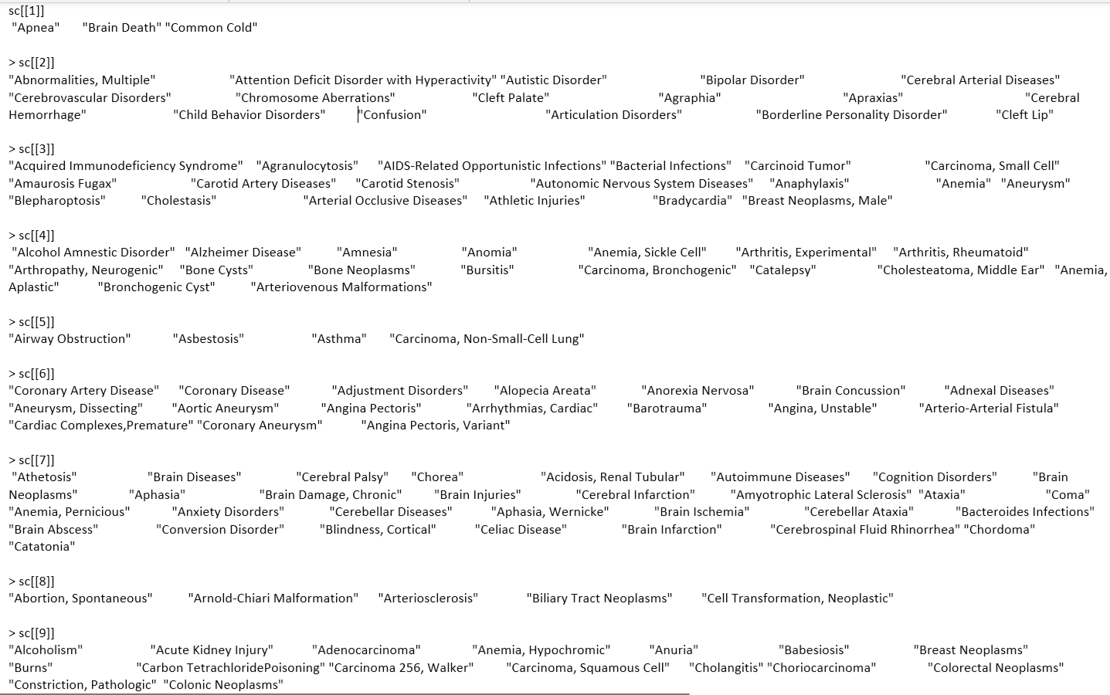
9 Communities Formed by Spinglass

Slide 27
9 Communities Formed by Spinglass
Community | Represent | Size
1 | No certain pattern (small size) | 3
2 | Mental disorder | 16
3 | Immunological diseases | 19
4 | Hydatoncus or inflammation | 17
5 | Respiratory system related diseases | 4
6 | Heart diseases | 17
7 | Cerebral disease | 30
8 | No certain pattern (small size) | 5
9 | Tumor/cancer/damage to organs | 16

Slide 28
Keyplayer Detection
Who are the most effective ones to affect the whole graph (for each community pick one) ?
Who are the most effective ones in its own individual community?
Who are the most effective ones (regardless of community) to affect the whole graph?

Slide 29
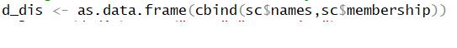
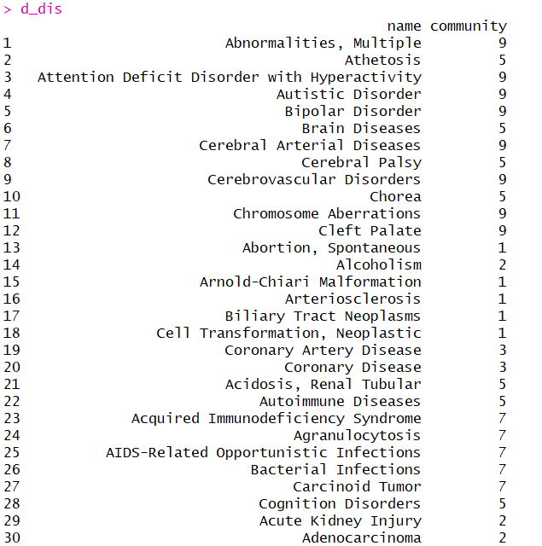
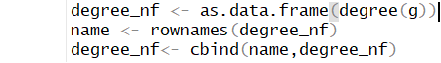
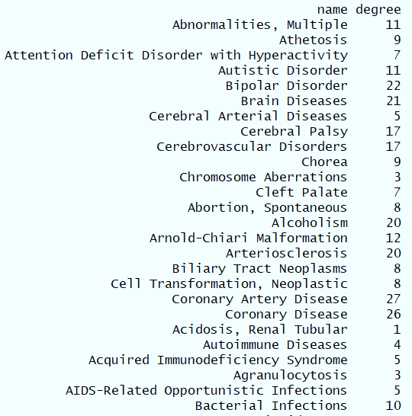
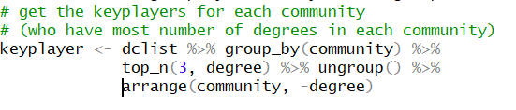
Keyplayer Detection Using 4 Measurements
4 measurements: Degree/Betweenness/Closeness/Weight (use degree-based as example)
1. Assign diseases into each community
2. Find number of degrees for every disease
3. Join two tables and get the keyplayers for each community

Slide 30
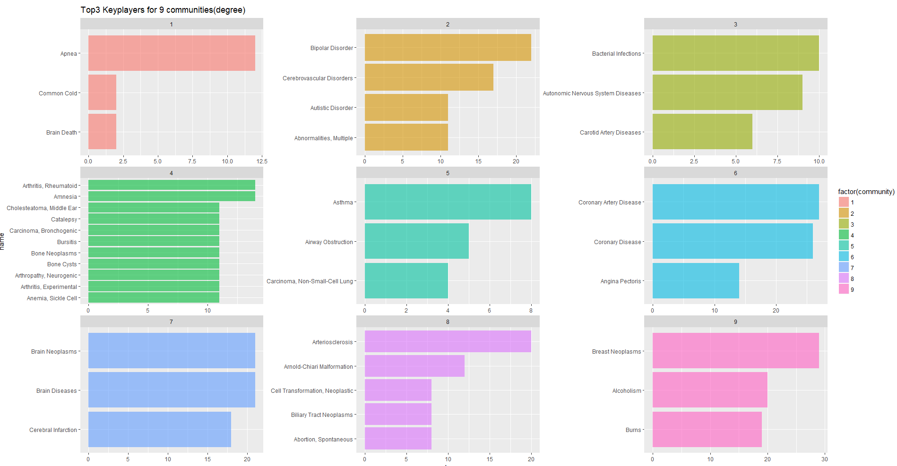
Top 3 Keyplayers For 9 Communities (Degree)

Slide 31
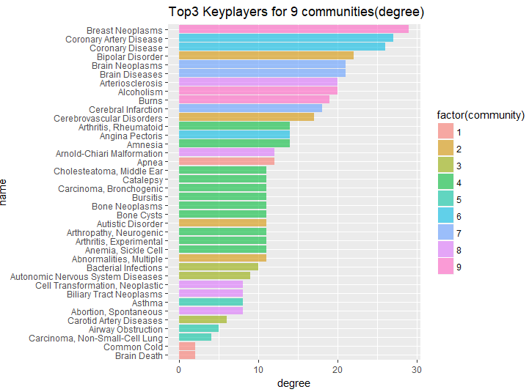
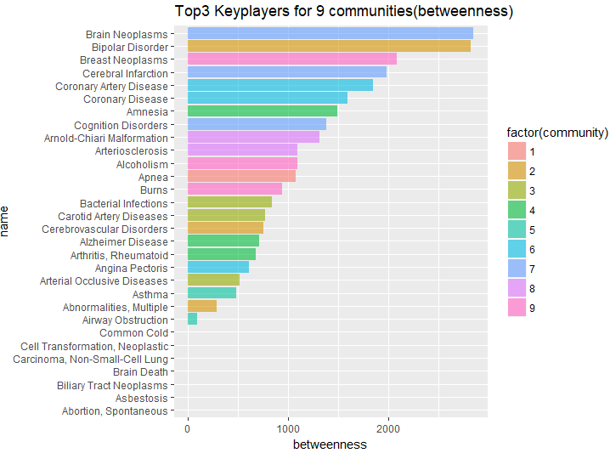
Degree
Betweenness

Slide 32
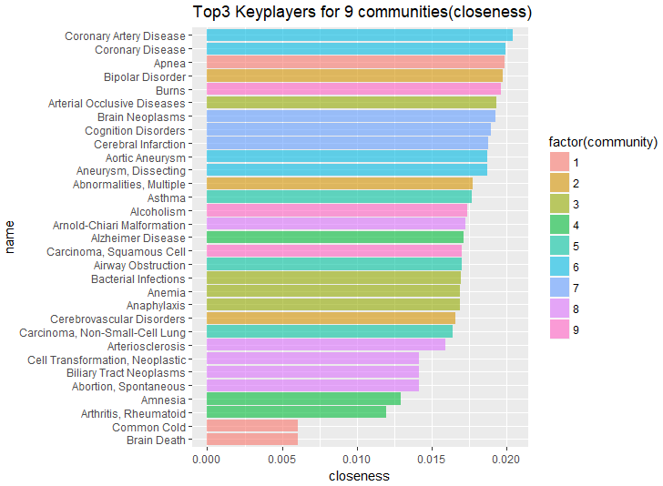
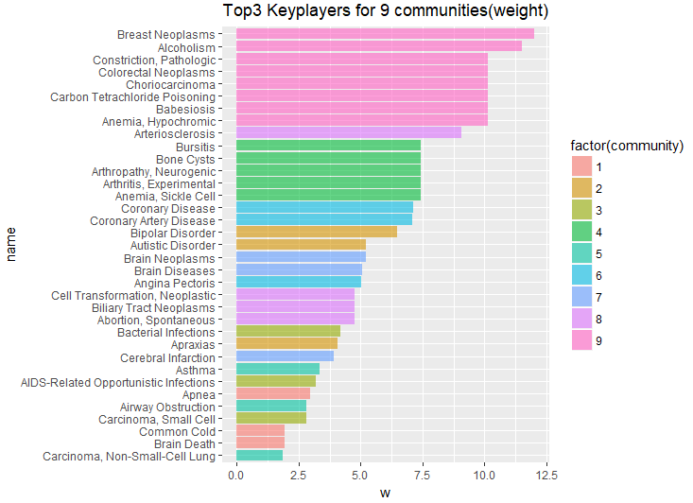
Closeness
Weight

Slide 33
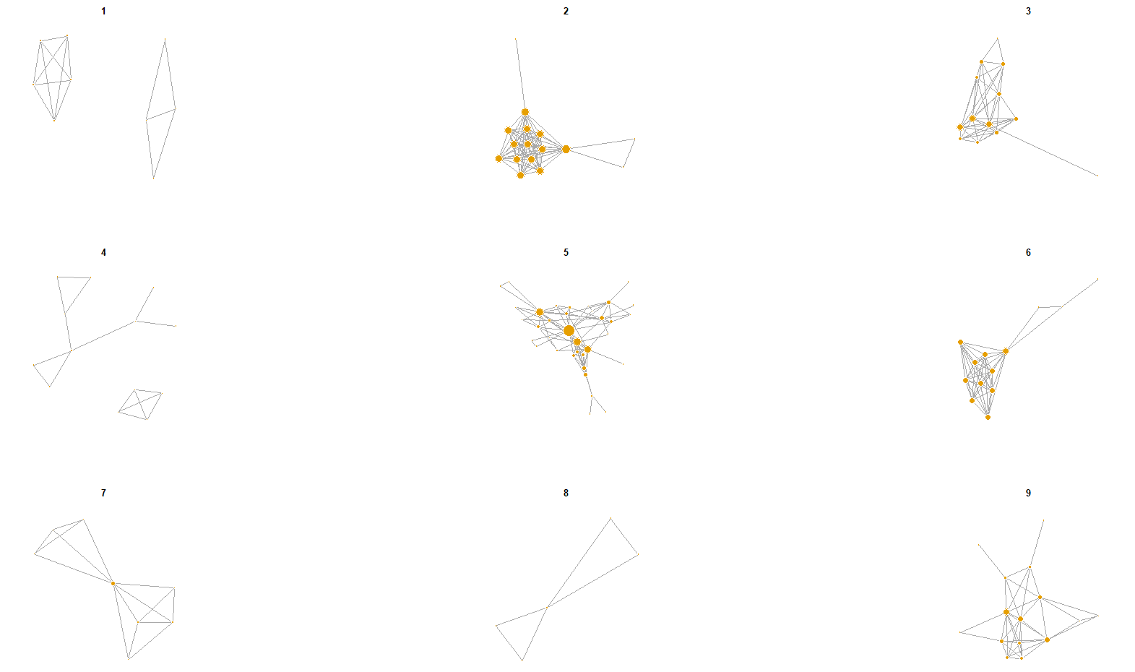
Top 1 Keyplayer in Each Community (Different Measurements)
community | degree_based | betweenness_based | closeness_based | weight_based
1 | Apnea | Apnea | Apnea | Apnea
2 | Bipolar Disorder | Bipolar Disorder | Bipolar Disorder | Bipolar Disorder
3 | Bacterial Infections | Bacterial Infections | Arterial Occlusive Diseases | Bacterial Infections
4 | Amnesia; Arthritis, Rheumatoid | Amnesia | Alzheimer Disease | Anemia, Sickle Cell; Arthritis, Experimental;Arthropathy, Neurogenic; Bone Cysts; Bursitis
5 | Asthma | Asthma | Asthma | Asthma
6 | Coronary Artery Disease | Coronary Artery Disease | Coronary Artery Disease | Coronary Disease
7 | Brain Diseases; Brain Neoplasms | Brain Neoplasms | Brain Neoplasms | Brain Neoplasms
8 | Arteriosclerosis | Arnold-Chiari Malformation | Arnold-Chiari Malformation | Arteriosclerosis
9 | Breast Neoplasms | Breast Neoplasms | Burns | Breast Neoplasms

Slide 34
Find the Most Effective Ones in Each Community
View each community as an individual graph (break the links between communities, and then to get the most effective ones in each community)
Community | degree_based | betweenness_based | closeness_based | weight_based
1 | Apnea; Brain Death; Common Cold | Apnea; Brain Death; Common Cold | Apnea; Brain Death; Common Cold | Apnea; Brain Death; Common Cold
2 | Bipolar Disorder | Bipolar Disorder | Bipolar Disorder | Autistic Disorder
3 | Bacterial Infections | Bacterial Infections | Arterial Occlusive Diseases | Bacterial Infections
4 | Amnesia; Arthritis, Rheumatoid | Amnesia; Arthritis, Rheumatoid | Amnesia | Anemia, Sickle Cell; Arthritis, Experimental; Arthropathy, Neurogenic; Bone Cysts; Bursitis
5 | Airway Obstruction; Asthma | Airway Obstruction; Asthma | Asthma | Airway Obstruction
6 | Coronary Artery Disease | Coronary Artery Disease | Aneurysm, Dissecting; Aortic Aneurysm | Coronary Artery Disease
7 | Brain Neoplasms | Brain Neoplasms | Chorea | Brain Neoplasms
8 | Abortion, Spontaneous; Arnold-Chiari Malformation; Arteriosclerosis; Biliary Tract Neoplasms; Cell Transformation, Neoplastic | Abortion, Spontaneous; Arnold-Chiari Malformation; Arteriosclerosis; Biliary Tract Neoplasms; Cell Transformation, Neoplastic | Arnold-Chiari Malformation | Abortion, Spontaneous; Biliary Tract Neoplasms; Cell Transformation, Neoplastic
9 | Acute Kidney Injury | Acute Kidney Injury | Acute Kidney Injury | Anemia, Hypochromic; Babesiosis; Carbon Tetrachloride Poisoning; Choriocarcinoma; Colorectal Neoplasms; Constriction, Pathologic

Slide 35
Top 1 Keyplayer in Each Community (Different Measurements)
Community | KEYPLAYERS | Represent
1 | Apnea; Brain Death; Common Cold | No certain pattern (small size)
2 | Bipolar Disorder | mental disorder
3 | Bacterial Infections | immunological diseases
4 | Arthritis, Rheumatoid | hydatoncus or inflammation
5 | Airway Obstruction | respiratory system related diseases
6 | Coronary Artery Disease | Heart diseases
7 | Brain Neoplasms | cerebral disease
8 | Abortion, Spontaneous; Arnold-Chiari Malformation; | No certain pattern (small size)
9 | Acute Kidney Injury | Tumor/cancer/damage to organs

Slide 36
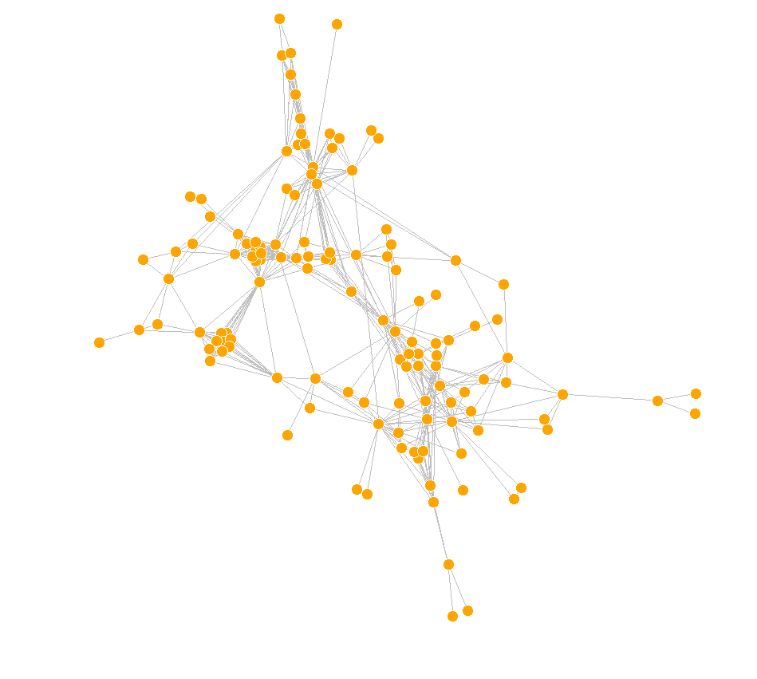
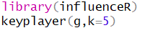
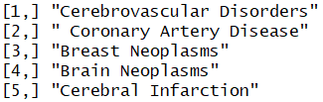
Find the Most Effective Ones in the Whole Graph
“脑血管障碍”
“冠状动脉疾病”
“乳腺肿瘤”
“脑肿瘤”
“脑梗塞”

Slide 37
04
Visualization & Insights

Slide 38
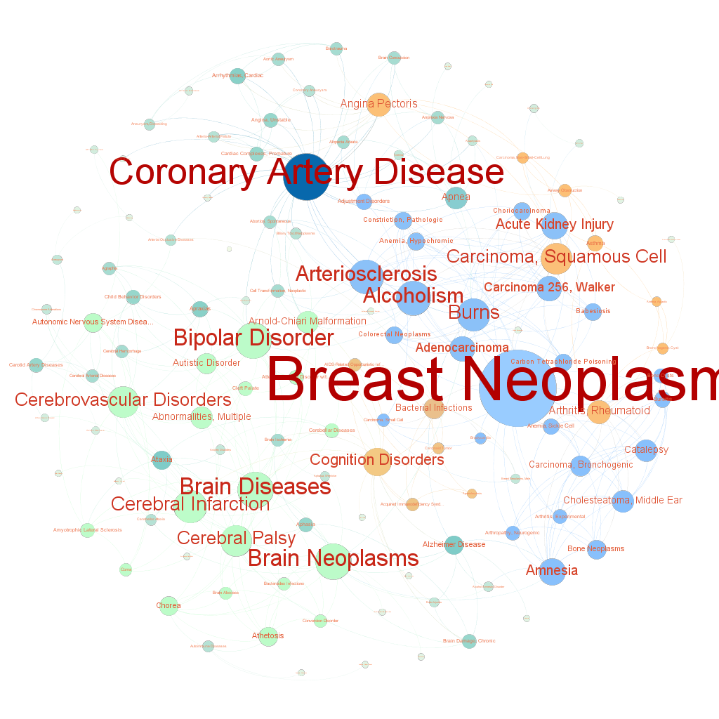
Backbone of Disease-Symptom Network
OVERVIEW
Gephi is a useful software for network analytics. Using Fruchterman Reingold layout, we get this circular network. You can see that Breast Neoplasms has the highest degree, Coronary Artery Disease comes the second.

Slide 39
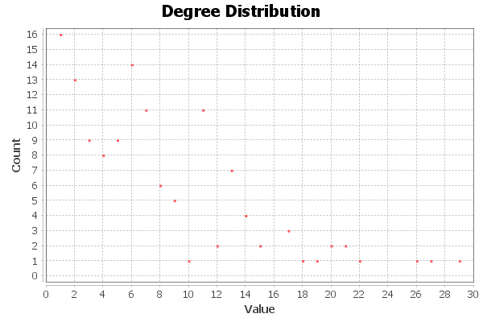
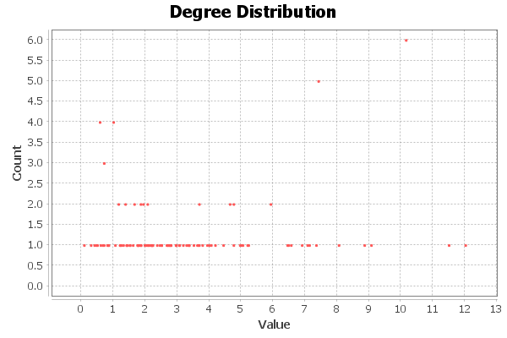
Average (Weighted) Degree of Disease-Symptom Network
Average Degree: 7.679
Average Weighted Degree: 3.424

Slide 40

Force Atlas 2 Layout Algorithm
Burns
Breast Neoplasms
Coronary Artery Disease
Coronary Disease
Arteriosclerosis
Arthritis Rheumatoid
Force Atlas 2 is an algorithm in the set of force-directed algorithms available in Gephi. It attempts to make a balance between the quality of the final layout and the speed of the computation algorithm.
Bipolar Disease
Cerebral Palsy
Cerebrovascular Disorders
Brain Diseases
Brain Neoplasms
Cerebral Infarction

Slide 41

Fruchterman Reingold Layout Algorithm
- The Fruchterman Reingold layout algorithm belongs to the class of force-directed algorithms. It is one of the standard algorithms in Gephi and is made use of quite often.
In the Fruchterman Reingold layout algorithm, the nodes are assumed to be entities made of steel and the edges are assumed to be springs. The attractive force between the nodes mimics the spring force, whereas the repulsive force between the nodes is analogous to the electrical force.
- This algorithm does not take into consideration the edge weight to come up with an optimal layout.
Burns
Arteriosclerosis
Coronary Disease
Breast Neoplasms
Coronary Artery Disease
Arthritis Rheumatoid
Bipolar Disease
Brain Neoplasms
Brain Diseases
Cerebral Palsy
Cerebral Infarction

Slide 42


Results
Brian
Adult
Arterial Blood Vessels
Coronary Disease
Bipolar Disorder
Arteriosclerosis

Slide 43

Results
Why?

Slide 44

THANKS
FOR YOUR WATCHING

